Slide 1
Countryside high school Center for computer technologies (cct)
Designated as a pcs center of excellence

Slide 2
Whether you are looking at MIT or ITT, the Center for Computer Technologies may be the ticket for you!
Computer Information Systems professionals focus on how to store, process, and manage information using computer technologies.

Slide 3
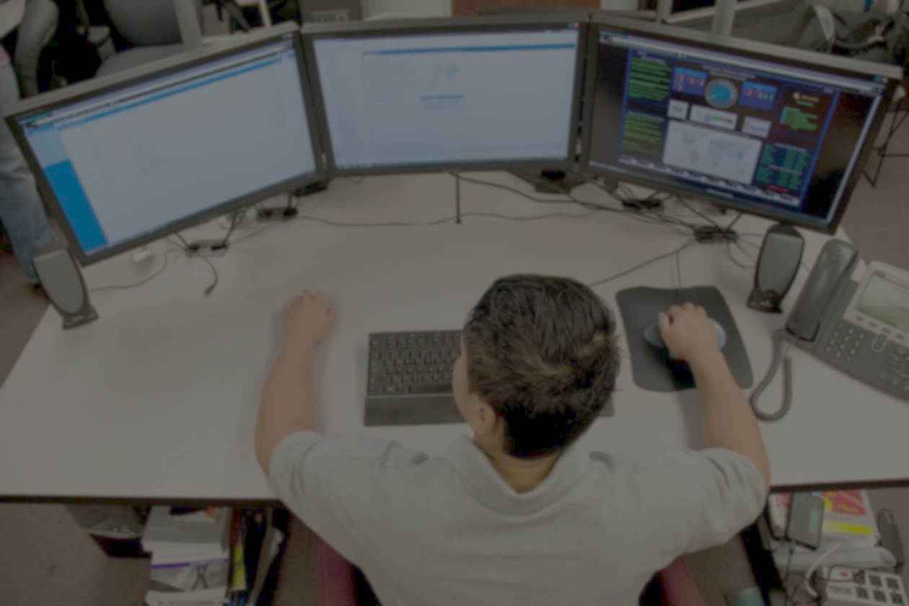
Computer networking professionals manage the communications between computer systems and devices.
Cybersecurity professionals protect digital information against tampering, theft and other cyber crimes.
Computer forensic specialists focus on the recovery, analysis and presentation of computer data for use as evidence in criminal investigations.
Digital and web designers use graphic design, programming, and web content to create and manage media and websites. Students use both creative and technical skills.

Slide 4
Center for computer technologies (cct) is:
Focused on coursework that is aligned with challenging academic standards.
Centered on content in technical knowledge and skills.
Applied learning with specialized activities.
Opportunities to earn IT industry certifications (grades 9-12):
Microsoft Word CompTIA A+
Microsoft Excel CompTIA Network+
Microsoft Powerpoint CompTIA Security+
Microsoft Networking Fundamentals Adobe Photoshop
Microsoft Security Fundamentals Adobe Dreamweaver
Microsoft Windows OS Fundamentals

Slide 5
CCT Four Year Plan 9th and 10th grades
9th grade: English I (H) or English II (H)
Algebra or Geometry (H) or Algebra II (H)
Earth Science or Biology (H)
American Government (H) or Global Studies
Intro to Information Technology (IIT)
Electives (x2)
10th grade: English I (H), English II (H) or AP Language
Geometry (H) or Algebra II (H) or Analysis of Functions or Pre-calculus
Biology (H) or Chemistry I (H)
World History (H) or AP World History
Computer Systems and Info Tech (CSIT) or Digital Design or Web Design
HOPE
Elective

Slide 6
CCT FOUR YEAR PLAN 11TH AND 12TH GRADES
11th grade: English 3 (H) or AP Lang or AP Lit or Comp I dual enrollment
Analysis of Functions or Precalc or AP Calc or AP Stats or dual enrollment
Chem I (H) or Physics I (H) or dual enrollment
US History (H) or AP US History or dual enrollment
CSIT Essentials or Digital Design or Web Design
Electives (x2)
12th grade: English 4(H) or AP Lit or Comp I/II or dual enrollment
Analysis of Functions or Precalc or AP Calc or AP Stats or dual enrollment
Physics I (H) or AP Biology or AP Chem or AP Physics or dual enrollment
Economics (H) or dual enrollment
CSIT Network Systems Configuration or Digital Design or Web Design
Elective (could be CSIT Network Systems Design & Admin)
Elective

Slide 7
Any 9th or 10th grader who lives in the north county application area may apply to cct
North County Application Zone is:
Carwise Middle
Clearwater Fundamental (only those students north county)
Dunedin Highland Middle
Palm Harbor Middle
Safety Harbor Middle
Tarpon Middle
Countryside HS
Dunedin HS
Eastlake HS
Palm Harbor HS
Tarpon Springs HS

Slide 8
TO APPLY FOR COUNTRYSIDE ISTEM OR CCT:
Application period is open from January 8, 2014 through January 17, 2014
Visit the Pinellas County School Board website at http://www.pcsb.org
Log into the Student Reservation System using your Parent Portal user ID and password
Enter your five program selections from the list of programs
Request professional courtesy or sibling priority if you qualify and provide the requested information
Submit documentation to each school where an application was made by January 17th for any required information that is not already available to the school in Portal (private schools and out-of-district students take note!)
The acceptance period is February 6, 2014-February 13, 2014

Slide 9
Thank you for your interest in Countryside High school cct!
We look forward to serving you and our community by providing educated and certified scholars and workers!

